Slide 1
Implementation of SCD type 1 and Type 2
Submitted By
Maimoona Khilji

Slide 2
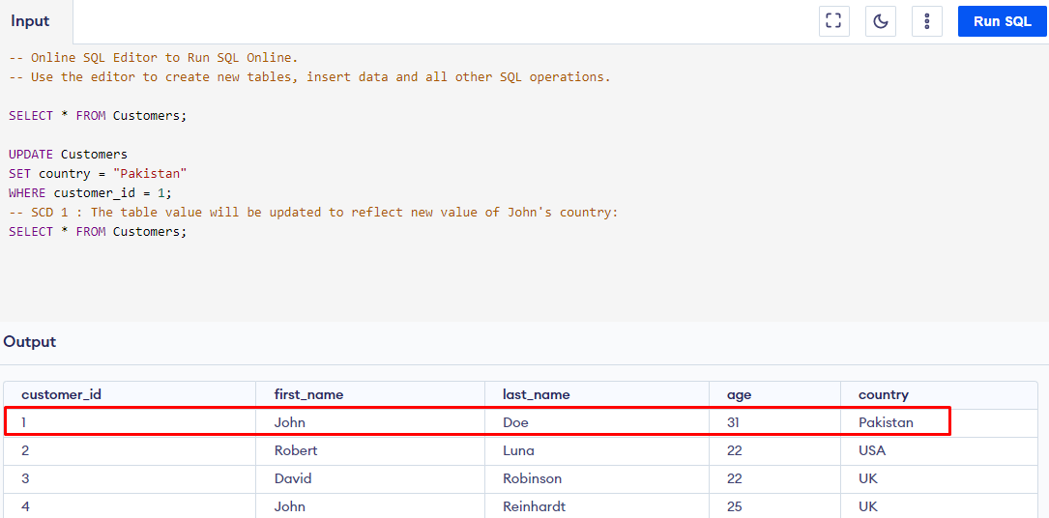
Type 1 SCD - Overwriting

Slide 3
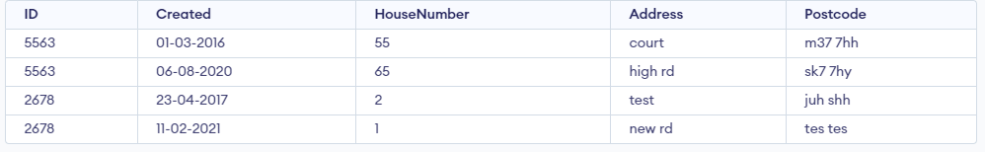
Type 2 SCD – Creating another dimension record
Notes:
insert into Data
values(5563,"06-08-2020",65 ,"high rd","sk7 7hy");
insert into Data
values(2678,"23-04-2017",2 ,"test","juh shh");
insert into Data
values(2678,"11-02-2021",1 ,"new rd","tes tes");

Slide 4
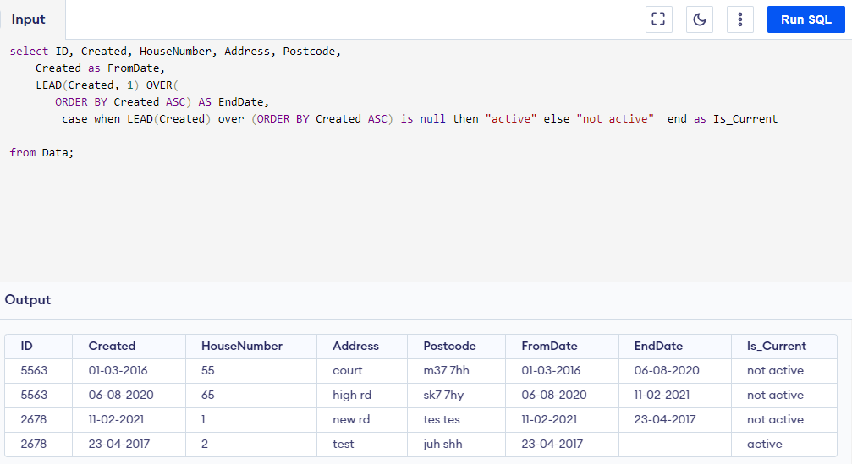

Slide 5
THE END

